Slide 1

Specialized Programming ES/MS/HS Principal
Megan Waugh
Department of English Language Development
WCSD Academy February 7, 2025

Slide 2

OUTCOMES for the YEAR
By the end of the year participants will have a clear understanding of what planning and instruction of academic language looks like and sounds like across all content areas and how to build the proficiency levels of English Learners so that ALL students have access and comprehensibility of academic language.

Slide 3

Ranking Top 5 Duties and Tasks
After providing a list of duties and tasks the ELF can perform, administrators were asked to rank the top 5 duties and tasks which were most important. The duties and tasks ranked most important are listed first below, overall, and by school level.*
Rank | Duties and Tasks | #1 Choice | # Top 5 Votes
1 | Co-Plan/Co-Teach/Co-Assess/Co-Reflect | 14 | 39
2 | Coach/Support EL Staff | 14 | 38
3 | Collect and Analyze Language Data | 5 | 36
4 | Support PLC Meetings (Data and Planning) | 1 | 27
5 | Learning Walks and EL Shadowing | 4 | 23
6 | Present Prof. Learning | 2 | 21
7 | Newcomer Support | 3 | 11
8 | Prep for Co-Teach, PL, PLCs, Coaching | 0 | 7
9 | Screening, Paperwork, Monitoring | 1 | 5
10 | MTSS and Advocacy | 0 | 5
11 | Family engagement and support | 0 | 4
12 | Attending Professional Learning | 0 | 3
13 | Support in Design/ Implementation of SPP | 0 | 1
Top 5 Duties and Tasks Among ES Administrator
Rank
1 | Co-Plan/Co-Teach/Co-Assess/Co- Reflect
2 | Coach/Support EL Staff
3 | Collect and Analyze Language Data
4 | Support PLC Meetings (Data and Planning)
5 | Learning Walks and EL Shadowing
Top 5 Duties and Tasks Among MS Administrator
Rank
1 | Coach/Support EL Staff
2 | Collect and Analyze Language Data
3 | Co-Plan/Co-Teach/Co-Assess/Co- Reflect
4 | Learning Walks and EL Shadowing
5 | Present Prof. Learning
Finding: Most administrators (at all school levels) indicated that the top 6 listed duties and tasks are the important to them.
*Duties and Tasks were calculated but not reported for HS administration due to low n size.

Slide 4
Learning Intentions
I Am Learning...
I Will Know I Have Learned It When
I Can...
To systematically support teachers’ development in short and/or long-term planning for student language learning through quality observation, feedback and coaching….NEPF Administrator Instructional Leadership Standard 1 Indicator 3 and Standard 2 Indicator 2
Identify characteristics of a co-planning meeting
List the components of planning for language
Discuss with a partner the roles of language coach versus teacher during a planning meeting using comparison language
Create and provide reflective feedback aimed at the continual improvement of student outcomes

Slide 5
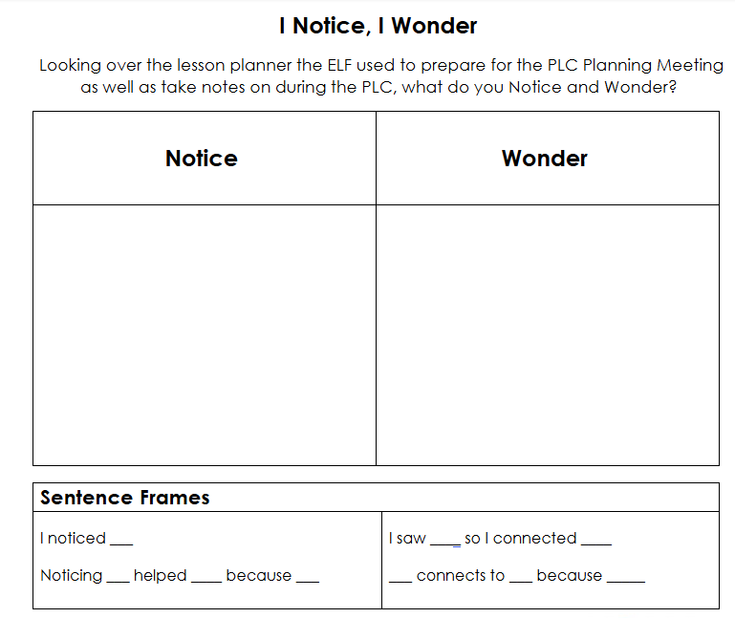
Planning for Language in Tier I Instruction

Slide 6

Conversation Grids

Slide 7
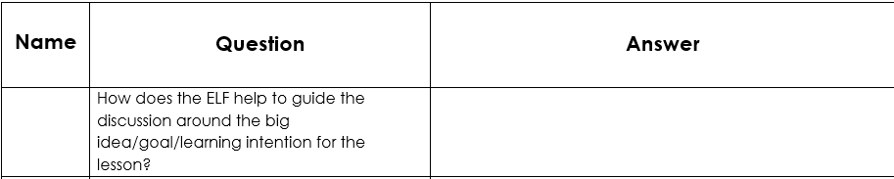

Slide 8
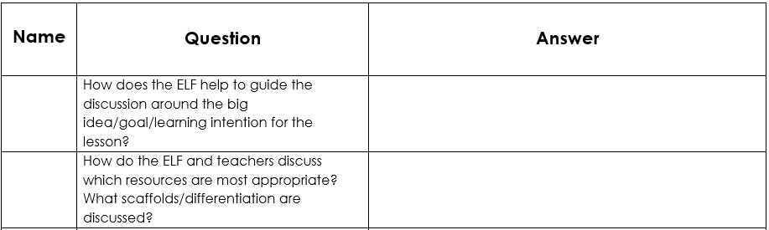

Slide 9
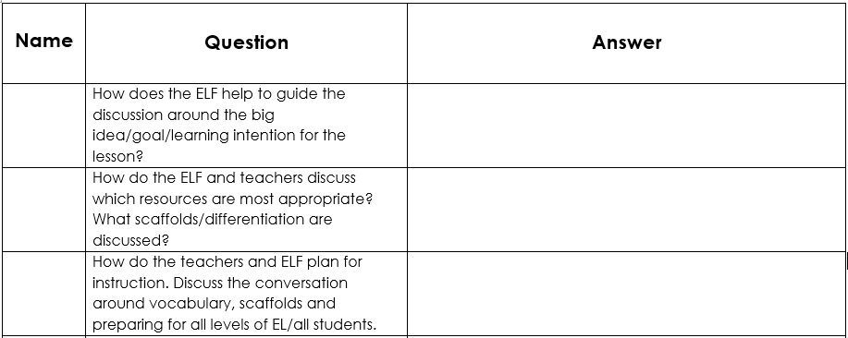

Slide 10
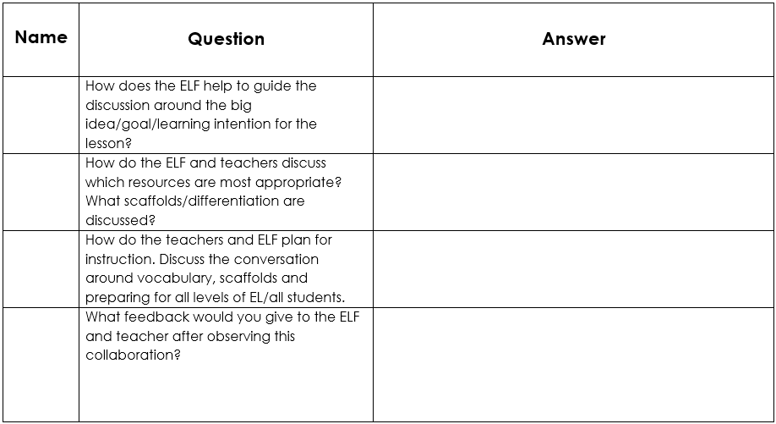

Slide 11
Perceptions of ELFs at School Site
Administrators were asked to rate their “level of agreement” with the following statements regarding how well ELFs are being received at their school sites. The percent agreement with each statement is presented below.
Finding: Overall, 71% of administration “agree” or “strongly agree” that teachers are seeking out assistance from ELF and the EL team at their school, and over 80% “agree” or “strongly agree” that the ELF is an asset at their school site. In addition, 90% of administrators indicated their school site has benefited from the having the ELF and that they welcomed by staff.

Slide 12
Learning Intentions
I Am Learning...
I Will Know I Have Learned It When
I Can...
To systematically support teachers’ development in short and/or long-term planning for student language learning through quality observation, feedback and coaching….NEPF Administrator Instructional Leadership Standard 1 Indicator 3 and Standard 2 Indicator 2
Identify characteristics of a co-planning meeting
List the components of planning for language
Discuss with a partner the roles of language coach versus teacher during a planning meeting using comparison language
Create and provide reflective feedback aimed at the continual improvement of student outcomes

Slide 13

Thank You!

